Slide 1

FHA Architecture Update and Planning
December 20, 2011

Slide 2

Agenda
FHA Overview and Initiatives
FHA Interoperability Architecture and FHIM Work To Date
FHA Challenges
FHA Architecture
  Management Perspective
  Interoperability Perspective
FHA Governance
FHA Partner Priorities Known To Date
Discussion and Next Steps
2

Slide 3
FHA Overview
Originally established in 2003 as an OMB Line of Business e-Government initiative
Initial focus was on identifying potential redundant investments in health IT across federal partners
Placed under Office of the National Coordinator when ONC was established in 2004
Focus evolved over time to emphasize federal advancement of the national agenda for health IT
Scope expanded to include enterprise architecture, standards adoption, tools and communication support
3

Slide 4
FHA Initiatives
Enterprise and Data Architecture
  Extending FEA for health (2002-2008)
  FHISE (2008-2010)
  FHIM (2009–Present)
  FHA Interoperability Architecture (2007-Present)
Standards Adoption
  Consolidated Health Informatics (2003-2006)
  Federal HIT Standards Adoption Workgroup (2006-2007)
  Terminology Initiative (2007)
  Federal Health IT Standards Related SDO Organizations Participation (2007-2009)
Investment Initiatives
  Federal Health Investment Planning and Reporting (2003-2087)
Tools
  CONNECT (2078-Present)
Communication Support
4

Slide 5
FHA Interoperability Architecture Work To Date
Instantiated the FHA repository and populated it with available high level federal health IT information
Worked with several partners to understand their perspectives and priorities related to FHA architecture
Populated FHA repository with relevant health initiative information and defined reports
Developed draft scope document for FHA architecture work
Developed draft governance and architecture management processes for engaging partners into FHA architecture work
Have been working with various initiatives including NIEM and S&I to leverage their work for architecture development
5

Slide 6
FHIM Work To Date
Information Domains Already Modeled
Person
Security and Privacy
Eligibility, Enrollment, Coordination of Benefits
Behavioral Health Assessments
Problems
Allergies
Orders (General)
Information Domains Currently Being Modeled
Lab
Medications/Pharmacy (including immunizations)Ongoing terminology modeling/value set definition workTwo prototypes to integrate the FHIM (and associated terminology models) with implementation modeling tools (MDHT) and leverage model driven architecture approach to generating implementation standards
Two prototypes to produce NIEM implementations using FHIM and MDHT
6

Slide 7
FHIM Work To Date
Ongoing work to integrate the IM Project/FHIM into the S&I Framework
  Use case requirements
  Harmonization of core concepts
  Implementation specifications
Ongoing work to support S&I Framework Initiatives
  Lab
  Transition of Care
  Query Health
  Public Health Reporting

Slide 8
What Are the Challenges Facing FHA?
Helping partners understand the collective set and value of FHA and ONC initiatives to ensure consistent program funding
Migrating CONNECT from internal to community management
Establishing a concrete mission with specific outcomes and performance measurements
Developing a successful engagement model for interacting with 30+ partners
Addressing health interoperability among partners and non-federal entities
Understanding and addressing partners’ health priorities
7

Slide 9
Management and Interoperability Architecture
Management Architecture
Understanding existing assets
Understanding assets being produced or planned for the future
Understanding roles and responsibilities for each FHA-related project
  Owners and participants
  Schedule and milestones
  Artifacts
  Performance metrics
  Alignment to key national health initiatives
    Meaningful Use
    S&I initiatives
    Agency initiatives – VLER, SSA LTD, CMS, etc.
Interoperability Architecture
Facilitate reuse of exchanges that have been developed
Move to standards based interoperability
Increases exchange accuracy
Improves development process
Enables cost efficient decisions
Shortens timelines
Coordinating federal strategies
8

Slide 10
Which Challenges Do the Architecture Perspectives Address?
Challenges | Management Architecture | Interoperability Architecture
Enable partner understanding | X
CONNECT migration | X
Establishing concrete mission | X
Developing partner engagement model | X
Enabling interoperability issues |  | X
Addressing health priorities |  | X
9

Slide 11
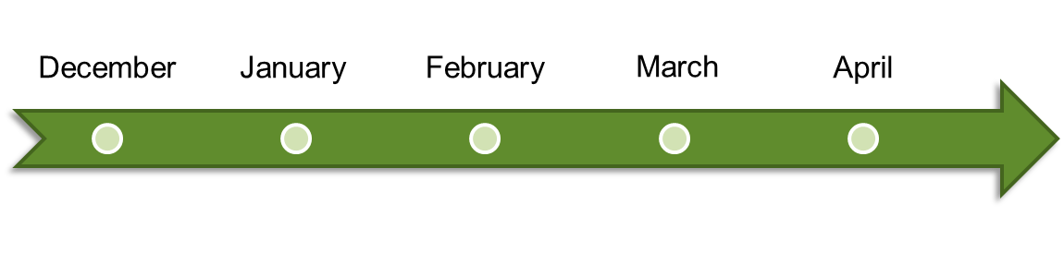





Architecture Development Plan
Management
Architecture
FHA Architecture
Governance
Interoperability
Architecture
Iterative Development
10

Slide 12
Management Architecture Characteristics
Fast, cheap, lightweight
Built on top of existing assets
Outcome is not just another model
Documents FHA-related projects
  Relates to national health initiatives
  Articulates value to FHA stakeholders (partners, OMB, others)
Does not depend on having FHA governance
11

Slide 13






Management Architecture Plan
1. Agree on relevant data set for Management Architecture
2. Collect and validate data on FHA projects
3. Relate FHA projects to federal initiatives
4. Enhance FHA repository and write reports
5. Create Management Architecture document
12

Slide 14
Management Architecture Summary
Deliverables
  Document summarizing FHA assets, projects, uses and relationships
  FHA repository to reflect relevant Management Architecture information
  FHA repository reports summarizing core Management Architecture information
Management Architecture deliverables will by completed by the end of February 2012
Management Architecture consists of:
  3 FTE core team for 10 weeks
  Additional SME consulting as needed
Benefit to stakeholders
  Summary view of the collective set of FHA initiatives
  Documentation of assets and artifacts that stakeholders can utilize to find relevant information
  Enables common understanding for the development of Interoperability Architecture
13

Slide 15
How does Management Architecture Enable Interoperability Architecture Development?
Management Architecture facilitates FHA strategic planning
Management Architecture summarizes ongoing initiatives and level sets the stakeholders’ understanding of the federal health IT space
Architecture identifies FHA projects that support the development of Interoperability Architecture
Management Architecture assists in developing the governance necessary for Interoperability Architecture
14

Slide 16
Interoperability Architecture Characteristics
Explains how FHA assists partners in improving interoperability with each other and non-federal stakeholders
Focuses on both current exchanges and potential future exchanges
Provides ultimate FHA roadmap which describes how to architect and implement standards-compliant exchanges
Utilizes iterative development
  Wide and shallow first
  Depth added in subsequent iterations
15

Slide 17
Example of Exchange Analysis
Federal
Other – state, local,
commercial
CMS
NIEM messages and CDA documents
Paper
CDC
Paper
VA
NIEM messages and CDA documents
NIEM messages and CDA documents
HL7 v2
NIEM messages and CDA documents
Non-
Federal
DHS
DoD
Paper
Business Architecture – business use cases, processes, requirements supported
Information Architecture – information, terminologies, value sets exchanged and applicable standards
Systems Architecture – source and target systems, information exchange standards
Paper-based exchanges or standards such as HL7 v2
Current exchange
Supported by a variety of models and tools
NIEM messages and CDA documents
Future exchange
Supported by FHIM and MDHT
16

Slide 18
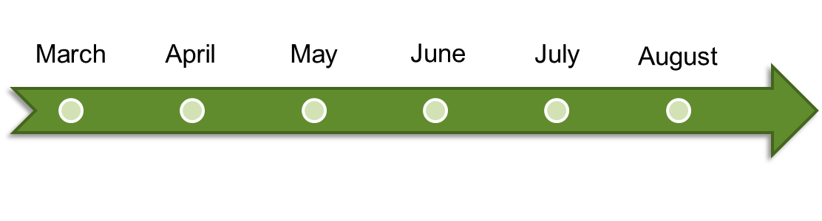






Interoperability Architecture Plan
ITERATION 1
1.1 AS-IS Architecture
1.2 TO-BE Architecture
1.3 Roadmap
ITERATION 2
2.1 AS-IS Architecture
2.2 TO-BE Architecture
2.3 Roadmap
ADDITIONAL ITERATIONS
17

Slide 19
Interoperability Architecture Summary
Deliverables (after each iteration)
  Document summarizing existing exchanges and future recommended exchanges including:
    Business Architecture – business processes supported
    Information Architecture – data sets exchanged and applicable standards
    Systems architecture – source and target systems, and applicable interfaces
  FHA repository to reflect relevant exchanges and information about them
  FHA repository reports summarizing relevant information about exchanges
  Harmonized UML model of the FHIM information domain(s) modeled
  Spreadsheet of FHIM information concepts for the information domain(s) modeled
  Spreadsheet mapping existing standards to the FHIM information domain(s) modeled
Interoperability Architecture deliverables will by completed by the end of three month long iterations (i.e. May, August, etc.)
18

Slide 20
Interoperability Architecture Summary
Interoperability Architecture consists of:
  4 FTE core team for 3 months per iteration
  Additional SME consulting as needed
Benefit to stakeholders
  Enables understanding and improvement of health interoperability between stakeholders
  Addresses partners’ health priorities
  Enables federal strategic planning for Health IT
  Advances standards-based information exchange by producing a harmonized set of information, terminologies and value sets
  Provides a harmonized information model that can be leveraged by federal partners to create internal databases that are consistent with information standards
  Provides integrated, model-based tools to assist federal partners in developing instance implementations of information exchange standards

Slide 21

FHA Governance Structure
Proposal for a new structure
that would:
  Align with original FHA governance model
  Create more strategic focus and direction
  Streamline board structure
  Continue to provide venue for Federal agency participation and input
  Enable funding partners to more
  effectively provide programmatic
  guidance and direction
19

Slide 22


Federal Health Architecture (FHA) –
Proposed Governance Model
FHA Governing Board
Strategic Direction and Oversight
FHA Managing Board
FHA Advisory Board
Planning and Management
Architecture & Modeling Workgroup
Collaborative cross-agency work on specific areas of FHA focus
Data Exchange & Interoperability Workgroup
Communication & Coordination
Workgroup
20

Slide 23
FHA Governance – Technical Workgroups
Build out Federal Health Enterprise Architecture in priority areas
Facilitate collaboration across Federal health partners in aligning health architectures
Align the Federal Health Information Model with the S&I Framework
Align with Health Domain and NEIM
Architecture & Modeling
Develop overarching strategy and plan for data exchange and interoperability initiatives across partners and with private partners
Initiate collaborative efforts in priority areas
Align data exchange and interoperability initiatives with the S&I framework
Develop transition plan for moving CONNECT to open source, distributed development model
Data Exchange & Interoperability
Federal health investment planning and reporting
Interagency agreements
Communications and outreach on Federal health initiatives
Communication & Coordination
21
*Standing or ad-hoc Workgroups, as identified, recommended by Managing Board and approved by Governing Board

Slide 24

Architecture & Modeling
  Interoperability Architecture
    Focusing architecture on interoperability
    framework
    Populating HHS repository with FHA artifacts,
    creating reporting infrastructure and report templates
  Aligning Architecture Initiatives
    Federal Health Information Model (FHIM) work ongoing
      Modeling the Lab, Medications/Pharmacy and General Orders information domains
      Defining terminologies/value sets for the Person and Lab information domains.
    Aligning with NIEM pilot on Insurance Exchange modeling
    Aligning with Standards & Interoperability Framework
22

Slide 25
FHA Partner Priorities Known To Date
HHS
  Reuse of HHS EA repository
  NIEM conformance of artifacts and instantiation of NIEM health domain
  Leveraging of existing ONC and HHS initiative products
  “Middle-out” architecture
DoD
  Validation and reuse of business reference model
  Validation of FHIM and reference implementation development
  Map and gap missing terminology and standards
  Effective FHA architecture governance
  Create good FHA repository
VA
  Top-down approach for definition of FHA use, scope, processes, data, and services
  Common business reference model
  Reuse of the work already done between VA and DoD
  Common repository to store information
23

Slide 26
FHA Partner Priorities Known To Date
CMS
  Focus on future-oriented activities rather than legacy exchanges
  Inclusion EHR business processes and data exchanges
  Focus on reusable services due to budgetary constraints and needs to be more efficient
SSA
  Concern regarding the value of FHA architecture when balanced against limited resources
  Desire to reuse the work done by DoD, VA, and other partners
  Desire to revisit SSA models from prior activities related to HIT initiatives before committing to new contributions on FHA architecture
24

Slide 27
FHA Partner Priorities - FHIM
Finish modeling a core set of information domains (approximately 15 information domains)
Model terminologies/value sets to support the core set of information domains
Fully integrate the models (FHIM and associated terminologies/value sets) with the Model Driven Health Tools (MDHT)
From the models and MDHT, generate information exchange implementation standards that support two types of exchanges - documents (CDA) and messages (NIEM and HL7)
Leverage the models and MDHT to assist partners with implementing the information exchange implementation standards
25

Slide 28
Discussion and Next Steps
Obtain partner buy-in
Continue work on Management Architecture
Operationalize FHA governance
Refine partner priorities
26

Slide 29
Appendix
27

Slide 30








What’s the FHA Value Proposition?
Health IT interoperability:
    Artifacts that are a means to achieve interoperability (primarily for federal partners, but available to non-federal parties as well)
FHA PMO efficiently managing FHA:
    Establishing and maintaining a governance structure ensuring that work is prioritized, artifacts are delivered and their use is promoted
Other
S&I Exchanges
Other Federal
Other ONC
Agency-Non Agency
Exchanges
FHA S&I
Inter-agency Exchanges
FHA PMO
Management Architecture
Interoperability Architecture
28

Slide 31
Interoperability Artifacts and Their Value
Specifications of exchanges
  Helps the implementation of interoperability
Strict definitions of the data entities and terminology used in the exchanges
  Helps the implementation of exchange specifications (FHIM, NIEM, other)
Context where each specification apply (data mapped to process, i.e. use case)
  Helps assess the impact of new priorities
  Helps the selection and implementation of exchange specifications
Software to implement exchanges
  Helps enabling interoperability
Map of current health exchanges (As-Is) (organization and systems)
  Helps identify new priorities (by showing gaps)
  Helps assess the impact of new or changed health priorities
Map of future state (To-Be)
  Helps manage initiatives
  Helps identify new priorities (by showing gaps)
Training on the use of specifications and software
  Helps the selection and implementation of exchange specifications
29

